Slide 1

State Employer
Business Rules for BAM

Slide 2
Agenda
Using the CalPERS Website
Membership
Account Codes
Benefits
Working after Retirement
Resources

Slide 3
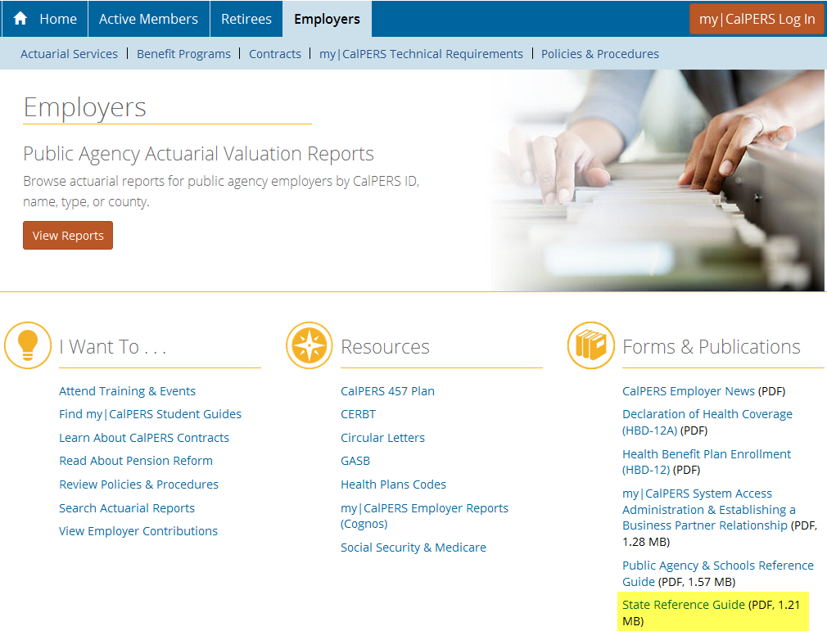

Slide 4
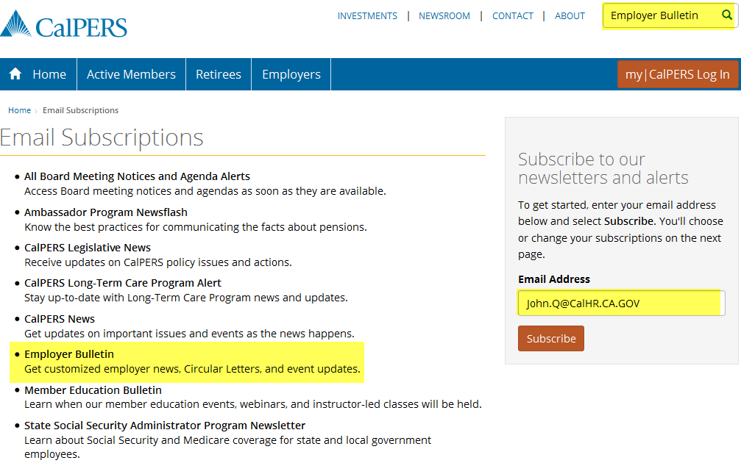

Slide 5
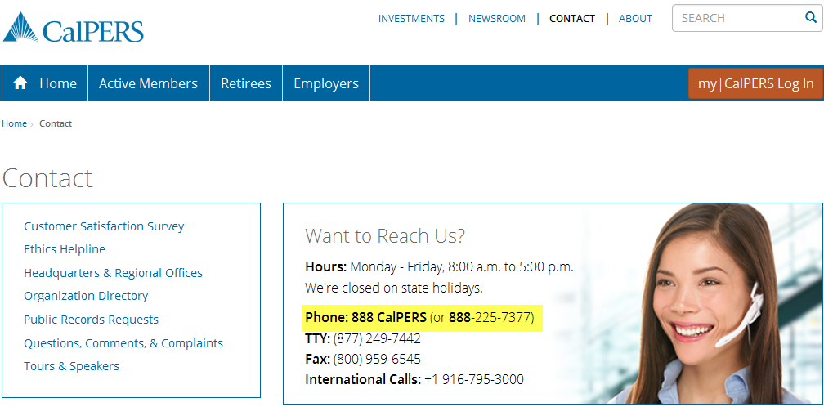

Slide 6
System Access Administrator (SAA)
  SAA responsibilities
  Managing access roles for staff
  Main point of contact for your agency
  Maintaining accounts

Slide 7
System Access Administrator
New Contact Checklist
  Meant to aid employers with SAA responsibilities
User Access Exit Checklist
  Deactivate contacts
  Reactivate a user account
  Locking and unlocking
  Deleting accounts

Slide 8
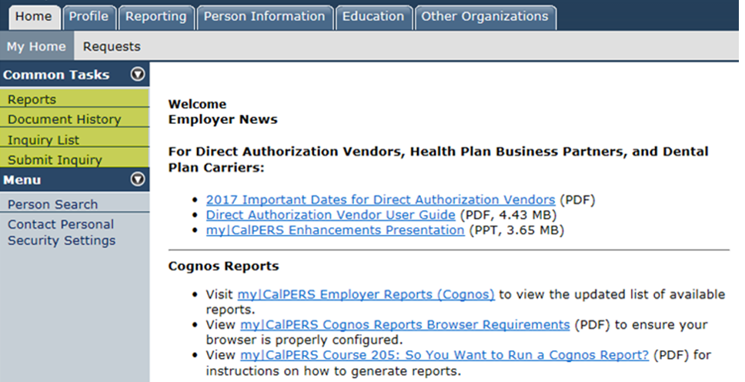

Slide 9
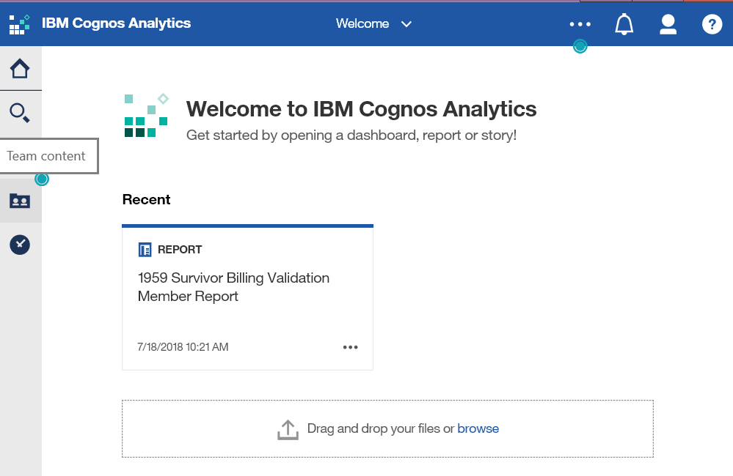

Slide 10
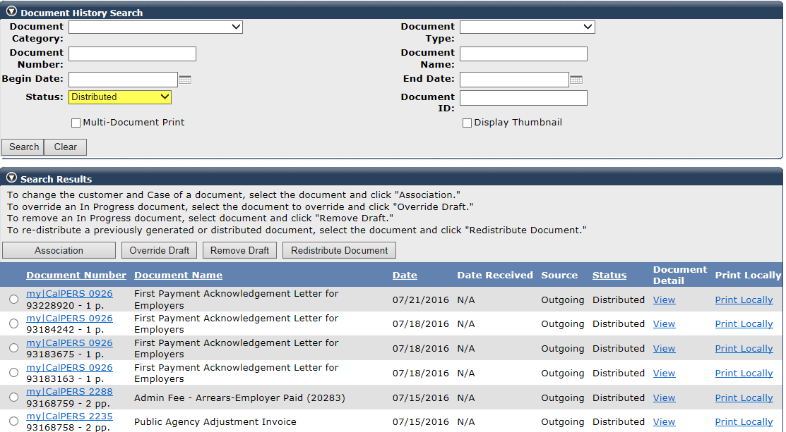
Document History

Slide 11
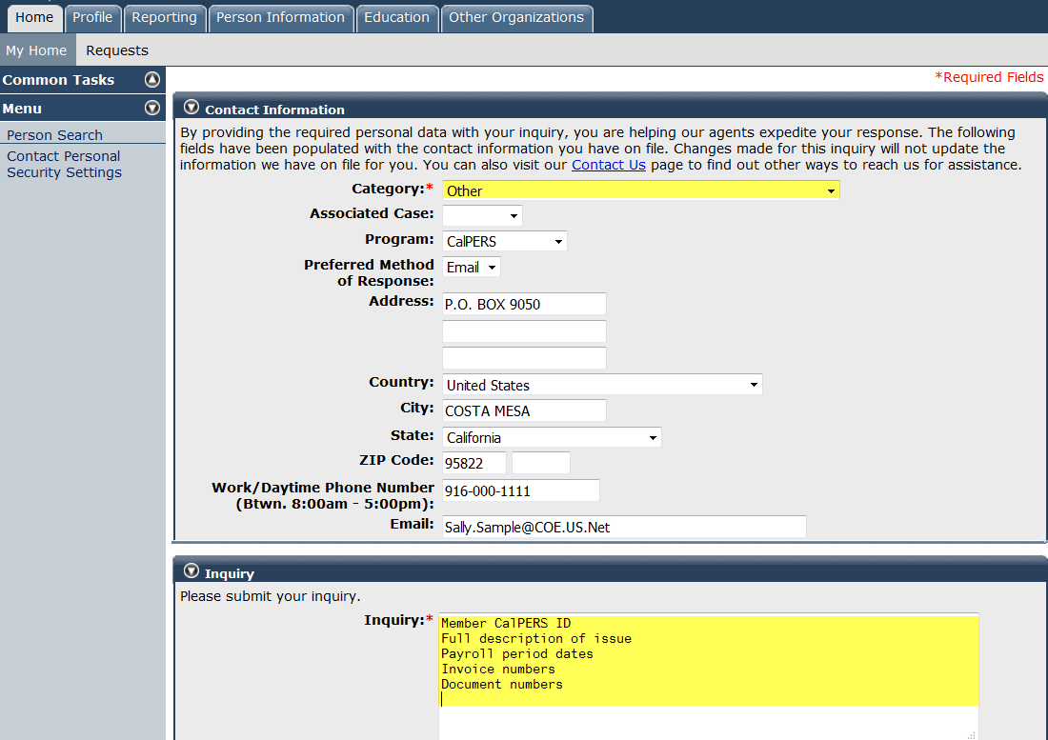

Slide 12

Membership Qualifications

Slide 13
Identifying membership status
Three methods of checking membership
  PIMS
  my|CalPERS - Person Information
  Customer Contact Center
    888 CalPERS (or 888-225-7377)
  Membership Unit Services Team
    Membership_Reporting@calpers.ca.gov

Slide 14
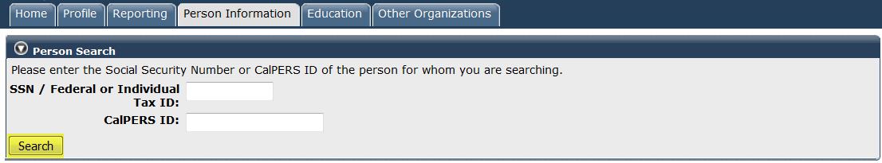
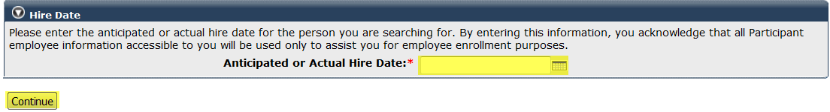
Person search

Slide 15
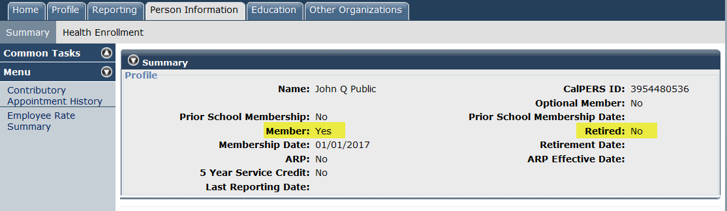
Person search

Slide 16
Identifying membership eligibility
Immediate membership required on date of hire
  Permanent full-time
  Part-time, 20 hours, one year or longer
  Temporary full-time, excess of 6 months

Slide 17
Identifying membership eligibility
Irregular time base – monitored positions
  Temporary agencies
  On-Call
  Seasonal
  Intermittent
  Part-time, less than 20 hours a week

Slide 18
Optional Membership – G.C. 20320 - 20324
Government code provides “optional” membership rights for elected and appointed officers of the state.
Optional members are excluded unless an election for membership is filed with CalPERS.
Four eligible classes:
  State Officers Elected by the People (my|CalPERS 0841)
  Appointees of State Officers (my|CalPERS 0842)
  Officers of the Senate or Assembly (my|CalPERS 0841)
  Legislative (my|CalPERS 0840)

Slide 19
Identifying membership eligibility
Excluded Membership – Government Code (G.C.) 20300
  Independent Contractors / Consultants / Contract Employees
  Excluded by law

Slide 20
Excluded Membership - G.C. 20300 - 20303
Members of other retirement system – for the same position
Health & Welfare or Trade Rate employment
Independent contractors
Inmates of state institutions
Student aides in the special schools of
  State Department of Education
California Conservation Corps participants

Slide 21
Documenting
  Notice of Exclusion
  Member Reciprocal Self-Certification

Slide 22
Notice of Exclusion
Offered to all who do not qualify
Provides specific reason for exclusion
Collect signature and provide copy to employee
Save document in employee file

Slide 23
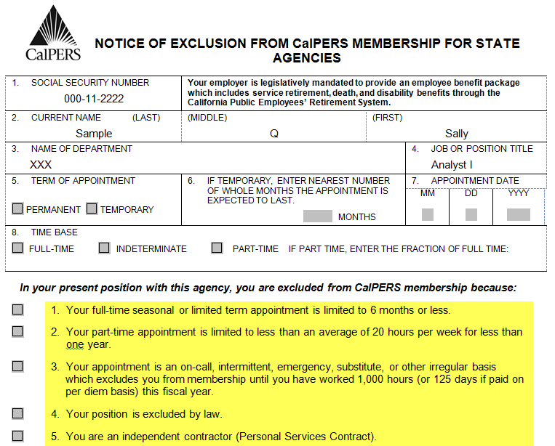
Notice of Exclusion Form - PERS AESD 139S

Slide 24
Enrollment Level – Public Employee Pension Reform Act (PEPRA)
Definition of a New Member – G.C. 7522.04
  No prior membership in any CA public retirement system
  prior to 1/1/2013
  Moved between public retirement systems after 1/1/2013
  and not eligible for reciprocity
  Break in service greater than six months
  All State departments, including CSU, are considered the same employer

Slide 25
Identifying membership eligibility
  Definition of a Classic Member – G.C. 7522.04
  Members that do not fit within the definition of “New Member”
  are considered “Classic Members”
  “Classic Members” will retain their existing retirement benefit formula(s)

Slide 26
Reciprocal Self-Certification
Offered to all new hires
Employee has 10 days
Determines benefit level
Does not establish reciprocity

Slide 27
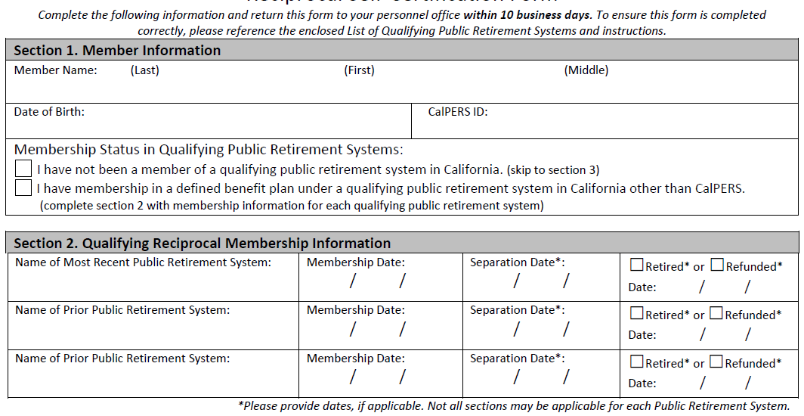
Reciprocal Self-Certification Form EAMD-801

Slide 28
Enrolling/reporting membership - G.C. 20283
Timely enrollment of employees into CalPERS
  90 day timeframe
  State and CSU appointments are added in PIMS
  my|CalPERS updates with appointment information from PIMS within 24 to 48 hours
  Not enrolled within 90 days then employer becomes responsible for member contributions and $500 administrative cost

Slide 29
Maintaining member status changes
Demographic changes are input via PIMS
  Name
  Address
  Social Security number
  Birth date
  Gender

Slide 30
Maintaining member status changes
Please keep your employees accounts updated with
  Begin leave of absence
  End leave of absence
  Permanent separation

Slide 31
Membership Information
Does the employee qualify for CalPERS?
  If NO, then place the member into Part-time, Seasonal and Temporary (PST)
  If YES, then employee contributes into CalPERS

Slide 32

Account Codes

Slide 33
Personnel Action Request (PAR)
Information needed to determine account codes:
Collective Bargaining Unit (CBU)
Member Category
Social Security
Medicare
Final Compensation period
Concurrent Employment
First tier or Second tier

Slide 34
Account Code Index
Personnel Action Manual - Section 2.62 Item 505
Contact Personnel & Payroll Services Division
  Customer Contact Center (916)372-7200
  if you need assistance

Slide 35
Benefits

Slide 36
Retirement Formulas – Miscellaneous
Classic
2.0% @ 55
2.0% @ 60
1.25% @ 65
New formula
2.0% @ 62
1.25% @ 67

Slide 37
Retirement Formulas – Safety
Classic
2.0% @ 55
2.5% @ 55
3.0% @ 50
3.0% @ 55
2.5% @ 55
2.5% @ 60
New formula
2.7% @ 57
2.5% @ 57
2.0% @ 57

Slide 38
State Benefit Provisions
  Minimum provisions
  Military Leave of Absence
  Sick Leave Credit
  Retired Death Benefit - $2,000
  Pre-Retirement option 2W

Slide 39
Service Retirement Eligibility
First Tier members
Age 50 for Classic and all Safety
Age 52 Miscellaneous as of 01/01/2013
5 years of Earned Service Credit
Second Tier members
Age 55
10 years of earned service credit

Slide 40
State Second Tier
  Second Tier
  Election required
  180 day election period
  Prospective election
  3.75% contribution rate
  1.25% @ 67

Slide 41
Service Retirement Calculation
Service
Credit
Final
Compensation
Benefit
Factor
Pension/Unmodified Allowance

Slide 42
Service Credit Earning Rates
Fiscal Year July 1 – June 30
  10 Months full-time employment = 1 year of service credit
Pay type | Service credit earned
Monthly | 1 month = one tenth (0.1)
Daily | 215 days = 1 year
Hourly | 1720 hours = 1 year

Slide 43
Common Service Credit Purchase Options
Redeposit of Withdrawn Contributions
Service Prior to Membership
Military Service
Leave of Absence

Slide 44
Benefit Factor
Determines the percentage of final compensation for years of service credit earned
Based on contracted Retirement Formula
Employee’s age at retirement
Employee’s birthday quarters

Slide 45

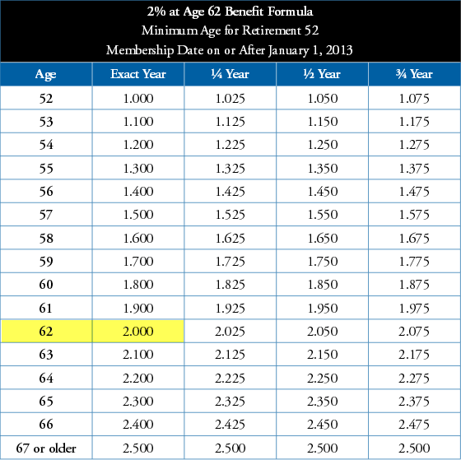
Birthday Quarters

Slide 46
Final Compensation
Based on employee’s reportable compensation
Not based on earnings
The highest consecutive 12 or 36 month period
Modified based on Social Security coordination

Slide 47
Service Retirement Calculation
Service Credit | X | Benefit Factor | X | Final Comp | = | Monthly Retirement
5 | X | 2.00 = 10% | X | $5,000.00 - 133.33 $4,866.67 | = | $486.66
 |  |  |  |  | +
20 | X | 2.00 = 40% | X | $5,000.00 | = Total | $2,000.00 $2,486.66

Slide 48


Working After Retirement

Slide 49
Retired Annuitant – G.C. 21220-21230
Eligibility wait periods
Bona fide separation in service (G.C. 21220.5) & (CCR 586.2)
Greater than 180 day break in service (G.C. 7522.56)
General requirements
Retiree compensation
Limited duration
Retiree skills
Extra Help

Slide 50
Retired Annuitant – G.C. 21220-21230
Reporting
Enroll RA within 30 days or $200.00 fee
Must report payroll & hourly pay rate or $200.00 fee
No contributions, no service credit earned, no benefits, no vehicles
Must not exceed 960 hours in a fiscal year, limited duration
Independent Contractor (CalPERS retiree - PEPRA)
Circular Letter 200-002-14 (1-14-14)

Slide 51
Reinstatement from a Service Retirement
Employer Responsibility
Provide firm start date
Complete section 2
Create new appointment
Report payroll
Pay employer contributions
Member Responsibility
Complete section 1 and 3 on reinstatement application
Send application to CalPERS

Slide 52

Resources

Slide 53
Additional Employee Support
Forms
Pre-retirement Beneficiary
Special Power of Attorney
Call CalPERS Immediately
Report imminent death
Death of active member

Slide 54
Employer and Member Education
Employer Education
Business Rules Training
System Training
Disability Training
Educational Forum
    Oakland
    October 2019
Member Education
CalPERS Benefits Education Events (CBEEs)
Webinars
Member Self-Service
Regional Office
  Retirement classes
  New member classes
Computer Based Training

Slide 55

Social Networking
Follow us on Twitter: http://twitter.com/CalPERS
Find us on Facebook: http://facebook.com/myCalPERS
View videos on YouTube

Slide 56
Thank you for joining us today.
The information provided in this presentation is for your convenience and reference as a general guide only and cannot be relied upon as an authoritative source for the law, practices, or policies of CalPERS. While CalPERS strives to include only accurate, timely and complete information in its employer training, sometimes information provided in printed materials may be or become inaccurate, untimely, incomplete, unclear or misleading. In all instances, the law then in effect, not this presentation, controls the application of the Public Employees' Retirement Law. It is the business partners responsibility to independently verify the accuracy of the information contained in this presentation before engaging in a course of action.

